Slide 1



ALLIES FOR HER
PROJECT PROPOSAL PRESENTATION
PRESENTED FOR
Perspective Panorama
PRESENTED BY
SAFESTRIDES: IoT-POWERED SAFETY SYSTEM FOR WOMEN
Nitheswaran K
Kaviya Priya M
Anitha M

Slide 2

ALLIES FOR HER
INTRODUCTION
GuardHer and GuardianStep form a comprehensive safety system designed specifically for women. GuardHer, a companion app, allows users to create a secure profile with essential information protected by a passkey. This data can sync with GuardianStep footwear, which features force sensors connected to a Microcontroller unit. Upon surpassing a preset threshold, these sensors trigger location transmission to the control panel and parental mobile numbers. Legitimate alerts are signaled through brief vibrations, with false alarms managed through app deactivation. Failure to deactivate prompts automatic transmission of user profiles to the control panel and nearby police stations. This integration of technology promotes gender equality, women's empowerment, and smart mobility. GuardHer and GuardianStep empower women by providing a secure platform and embedding safety features into everyday footwear, ensuring they can move confidently and safely in society.

Slide 3
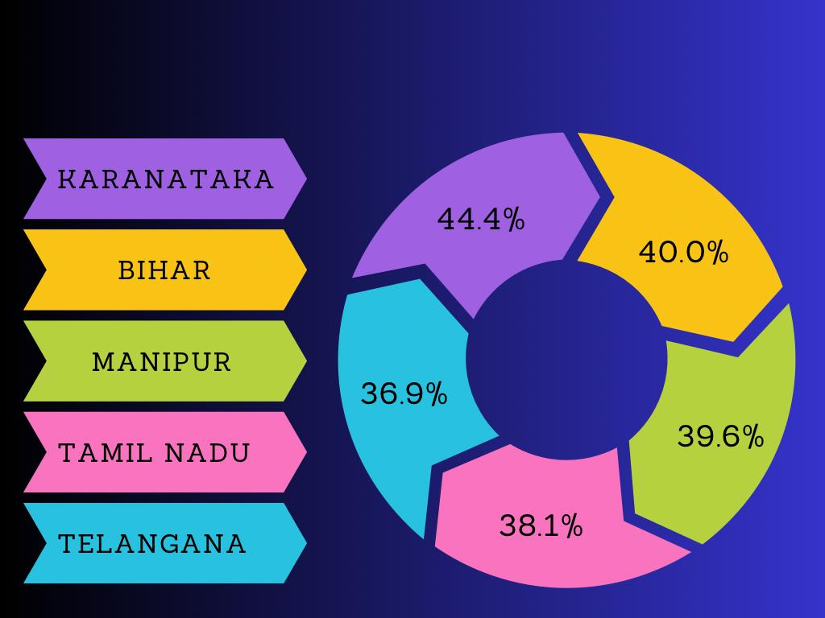
C
ALLIES FOR HER
Gender Equality & Women Empowerment
SDG GOAL NO :5
STASTICS:
The top 5 states in India which prompts to most of the violence against women.

Slide 4

ALLIES FOR HER
Problem Statement
The increase in violence and harassment of women in public sectors consequently increased the demands in solution for their security and safety. The problem is to develop a IOT based model for guarding woman from potential threats to make their navigation safer.
Proposed Solution
The solution for this problem is to develop a smart footwear with integrated sensor, GPS and modules to activate real time tracking and transfer of personal profile which contains Name, Photo, Mobile number, Working place of respective users to Control panel in case of force sensor is to ensure the women is safe and secure.

Slide 5
ALLIES FOR HER
BLOCK DIAGRAM
POWER SUPPLY
(10 volts)
MICRO CONTROLLER
(STM32H747I-DISCO)
&
(B-L475E-IOT01A)
LCD
(3 Volts)
GSM
SMS
FORCE SENSOR
IOT PAGE
VIBRATION MOTOR
(Output: 500 Watts)
GPS

Slide 6

ALLIES FOR HER
ABOUT THE IDEA
The product splits into two "GUARDHER" and "GUARDIANSTEP".
At first GUARDHER is an application where user will initially register with their personal details which is particularly only for women. After registration, they will be creating a wallet inside the application with a passkey to secure the details they provided. The Wallet contains a safe profile of their,
Photo b. Name
c. Mobile number
d. Working place
All the details were mandatory to maintain a profile in our app. Once the profile is created, they can link their wallet to the control panel or control room. This application "GUARDHER" profile will be linked with their respective "GUARDIANSTEP" footwear.
Secondly "GUARDIANSTEP" is a footwear integrated with a force sensor which gets activated once the user gives the pressure beyond the threshold limit with their foot. To distinguish the activation, the pressure threshold will be fixed slightly beyond the actual walking or running pressure by the foot. After the activation the current location of the user will be sent to the control panel as well as to the registered mobile number(parents/guardians). Then also the vibration motor which is fixed in their footwear gets activated to confirm the false alerts. If it is a false alert (randomly the sensor gets activated) the user can "Of' the vibration motor by entering into our application and to provide their particular Passkey they had given. If else the motor is destroyed or not turned off within a specific time limit, the profile in their wallet automatically sent to the control panel and the nearby police stations will get the needed information about the user with their photo. This footwear helps in faster recovery.

Slide 7
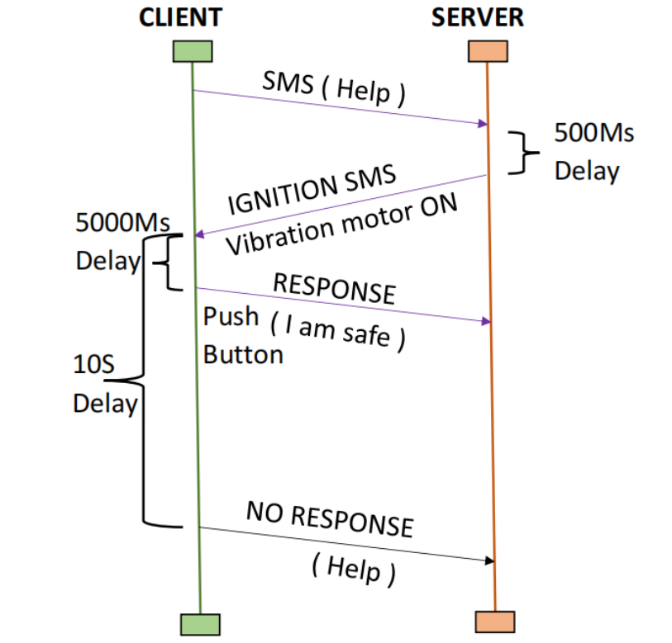
ALLIES FOR HER
CLIENT SERVER FLOW
Here the server is control room, client is the women.
After the women give the force by using the Sensor, then the GSM get Alert and send SMS like (“I am in danger, I need help” /n My live location is <https. live location link.com> /n About me <www.iot web page link.com>”).
Then the SMS will send to the parent and police control room, then the control room office will get aware and send a response ignition message as (“Vibration Motor ON”).
Then the motor get comment from GSM and then vibration act for 5 sec. If the women not in danger but the force get high and then SMS sent, then she get comment and get vibration means she response through the push button the reply message will send as “sorry sir. I am not in danger. Thank you for your care”. Else in danger there is no response from her, then the control officer will inform to the nearby police station they take care of her.

Slide 8
ALLIES FOR HER
COMPARISION
EXISTING | PROPOSED
It employs a manual activation method using a button to initiate user tracking. | The proposed solution utilizes a force sensor integrated into the footwear.
The user profile is not automatically transferred in dangerous situations. | The admin(Control Room) can access the user's profile which includes their necessary personal details specifically their photo for identification, which is automatically transmitted when the sensor is activated.
The key distinction lies in the activation mechanism and the handling of user profiles during emergencies. The proposed solution streamlines the process by automating activation through the force sensor, eliminating the need for manual intervention. Additionally, it enhances safety measures by ensuring that essential user information, including a photo, is promptly relayed to the admin in case of activation, facilitating quick response and assistance. This approach enhances the effectiveness and efficiency of the safety system, providing users with greater peace of mind and security.

Slide 9
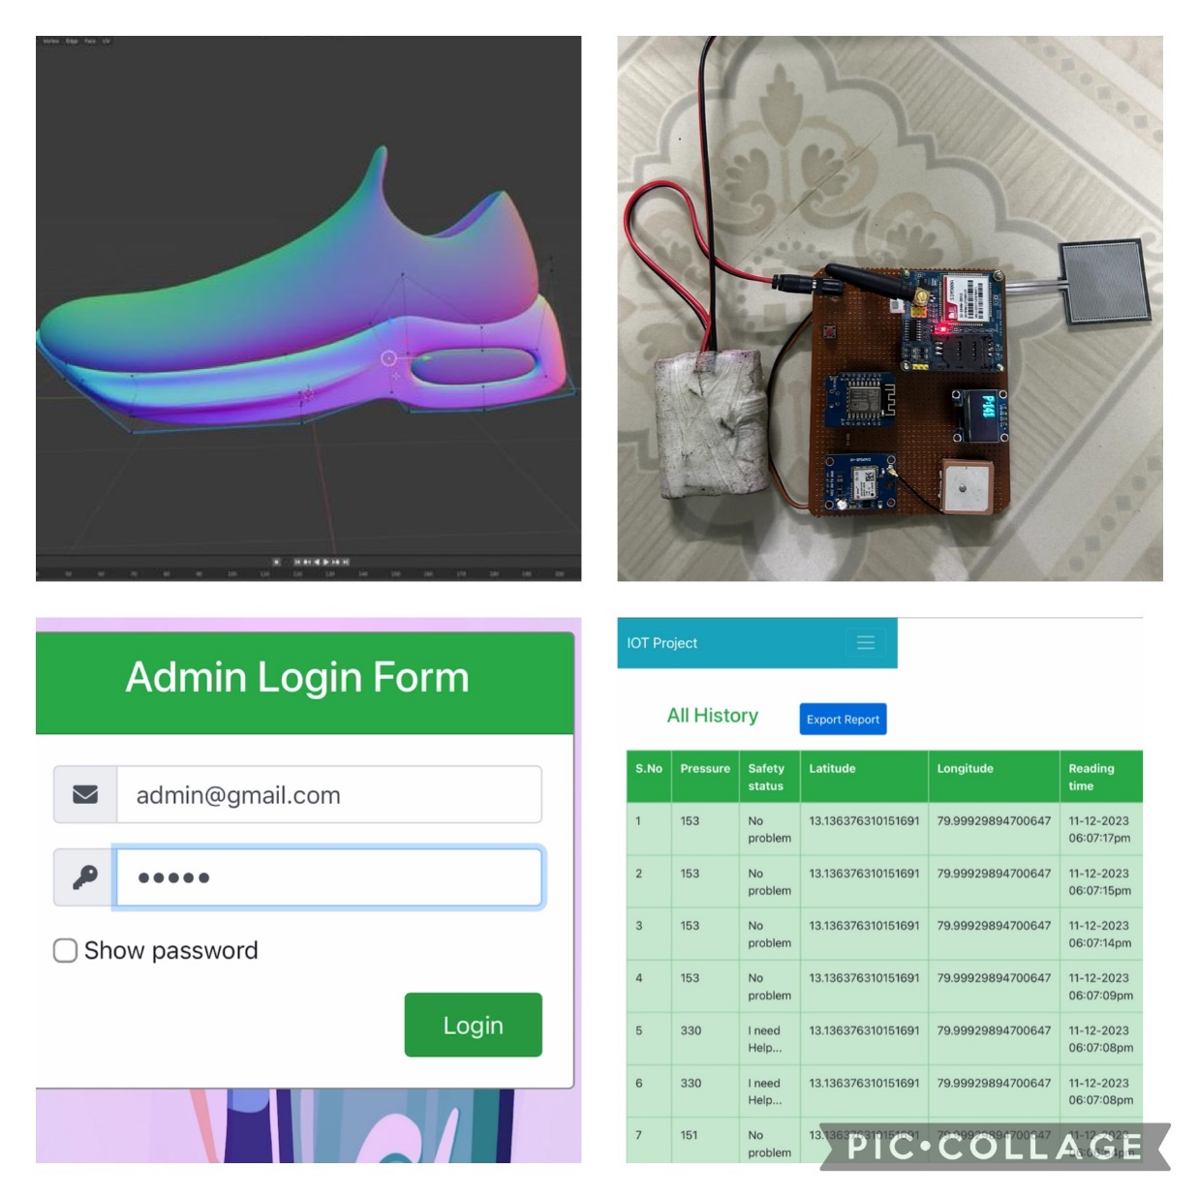
ALLIES FOR HER
COMPONENTS USED
PROTOTYPE IMAGE
S.NO | COMPONENTS | SPECIFICATIONS
1 | FORCE SENSOR | ROBODO SEN38
2 | MICRO CONTROLLER | STM32H747I-DISCO (&) B-L475E-IOT01A
3 | GPS | NEO-6M (Serial TTL Output)
4 | GSM | SIM900A GPRS 4G
5 | BATTERY | 12V, 1.3Ah
6 | LCD DISPLAY | 4156, 0.96 OLED BLUE SPI, 7PIN
PRODUCT
S.NO | COMPONENTS | SPECIFICATIONS | COST
1 | FORCE SENSOR | QLA414 NANO SENSOR | $21.00
2 | MICRO CONTROLLER | BEETLE | $20.05
3 | GNSS MODULE | MIA-M10 | $29.00
4 | ON-CHIP BATTERY | 12V, 1.3Ah | $19.50

Slide 10
C
ALLIES FOR HER
UNIQUE SELLING PROPORTION
Real-time Location Accuracy: Highlight precise GPS and location tracking that provides users and their loved ones with , information in emergency.
AI-Driven Threat Detection: Encourage the utilization of artificial intelligence for smart threat detection, ensuring the system's capability to differentiate between real threats and false alarms.
Mobile App: A mobile app that simplifies navigation and usage, making it even to those with limited tech expertise.
Discrete Wearable Design: Emphasize the discreet and fashionable design of the wearable device, making it easy for women to into their daily attire.
Privacy and Data Security : Provide users with robust privacy controls and advanced data security measures to safeguard their sensitive information, our system as highly trustworthy.

Slide 11
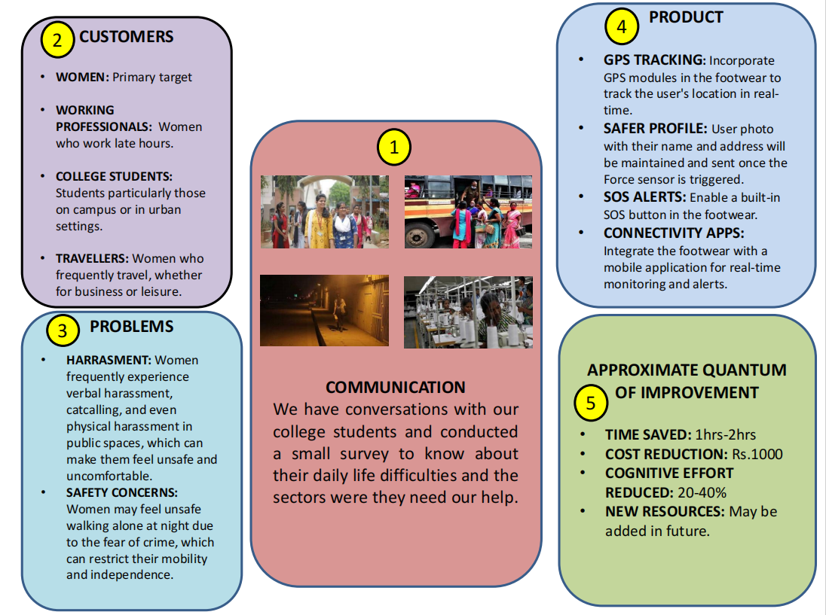
ALLIES FOR HER

Slide 12
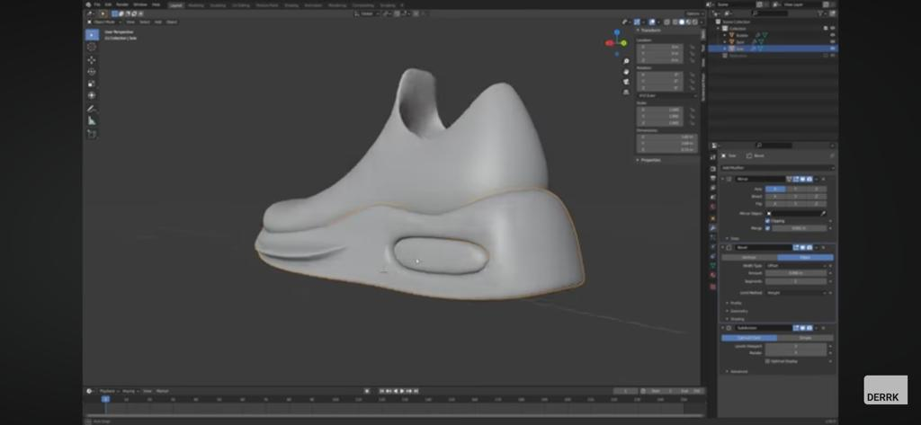
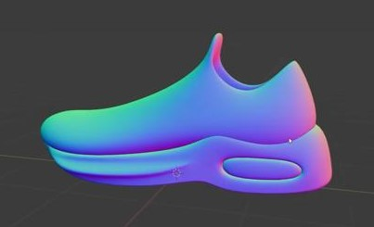

ALLIES FOR HER
3-D DESIGN USING BLENDER SOFTWARE
GITHUB LINK (code)
1. https://github.com/Nitheswaran07/HARDWARE_CODE.git
2. https://drive.google.com/file/d/1fLUnlWqE968yK_wSCe6n4-L4HFAZRae6/view?usp=drivesdk

Slide 13
ALLIES FOR HER
CONCLUSION
In conclusion, the implementation of a Women Safety System using IoT represents a significant stride towards creating a safer and more secure environment for women. By leveraging the power of interconnected devices and real-time data monitoring, this system addresses the pressing issues of personal safety. The integration of wearable devices, GPS tracking, and emergency response mechanisms ensures a rapid and efficient response to potential threats. As technology continues to advance, the Women Safety System demonstrates the potential for innovation in safeguarding individuals.

Slide 14
ALLIES FOR HER
REFERENCES
V. V. S. P. Reddy, K. B. S. L. Vamsi, S. M. Chandra, K. M. Rama and Y. Deepika,"Women Safety System with Nerve Stimulator using IoT Technology," 2022 2ndInternational Conference on Technological Advancements in Computational Sciences(ICTACS), Tashkent, Uzbekistan, 2022, pp. 376-379, doi:10.1109/ICTACS56270.2022.9988463.
M. S. Farooq, A. Masooma, U. Omer, R. Tehseen, S. A. M. Gilani and Z. Atal, "The Roleof IoT in Woman’s Safety: A Systematic Literature Review," in IEEE Access, vol.11, pp. 69807-69825, 2023, doi: 10.1109/ACCESS.2023.3252903.
P. C, B. B, P. C. M, P. R and S. M, "Raspberry Pi based Women Safety System," 20238th International Conference on Communication and Electronics Systems (ICCES),Coimbatore, India, 2023, pp. 74-76, doi: 10.1109/ICCES57224.2023.10192819.
Z. Ali, M. A. Khan, O. B. Samin, M. Mansoor and M. Omar, "IoT Based Smart Glovesfor Women Safety," 2021 International Conference on Innovative Computing (ICIC),Lahore, Pakistan, 2021, pp. 1-6, doi: 10.1109/ICIC53490.2021.9693086.
P. K. Panda, B. Mehtre, D. M. Sunil, M. Devanathan, B. K. Subhash and S. K. Panda, "A Compact Safety System for Women Security using IoT," 2020 IEEE InternationalConference on Technology, Engineering, Management for Societal impact usingMarketing, Entrepreneurship and Talent (TEMSMET), Bengaluru, India, 2020, pp. 1- 6,doi: 10.1109/TEMSMET51618.2020.9557450.
V. Gowrishankar, G. Prabhakaran, K. S. Tamilselvan, T. Judgi, M. Parimala Devi andA. Murugesan, "IoT based Smart ID Card for Working Woman Safety," 2023 7thInternational Conference on Intelligent Computing and Control Systems (ICICCS),Madurai, India, 2023, pp. 1598-1604, doi: 10.1109/ICICCS56967.2023.10142631.
Z. M. Tahmidul Kabir, A. M. Mizan and T. Tasneem, "Safety Solution for Women Using Smart Band and CWS App," 2020 17th International Conference on ElectricalEngineering/Electronics, Computer, Telecommunications and Information Technology(ECTI-CON), Phuket, Thailand, 2020, pp. 566-569, doi: 10.1109/ECTICON49241.2020.9158134.
Tayal, H. P. Govind Rao, A. Gupta and A. Choudhary, "Women Safety System Designand Hardware Implementation," 2021 9th International Conference on Reliability,Infocom Technologies and Optimization (Trends and Future Directions) (ICRITO),Noida, India, 2021, pp. 1-3, doi: 10.1109/ICRITO51393.2021.9596393.

